Slide 1
Interview Report
Presented by: Dipesh Tha Shrestha
Presented To: Akash Deo

Slide 2
I went to my friend house to take a interview about the website. I asked him some question about that website. Therefore, the answer provided by friend are given below in the slides.

Slide 3
GoGoAnime, what is it?
For people who don’t know what Gogoanime is, it is a wonderful website from where you can watch and even download the favorite anime shows at any time and any place. For fans who find it hard to source their favorite anime shows, can go to the website and enjoy their entertainment.
There is no fixed URL for Gogoanime since it is not legalized to feature the various anime shows on their website. So, it keeps on changing its URL, so that the authorities cannot shut it down. All you have to do is copy the URL and log into the website.
It is, however, advised for you to watch kiss anime legally, but for all those fans who do not have access to the legal anime websites, can always go to Gogoanime and watch their favorite shows. Don’t be surprised if someday you find it to be shut down since they keep on changing their URL to escape from being tracked down and removed from the search pages.

Slide 4
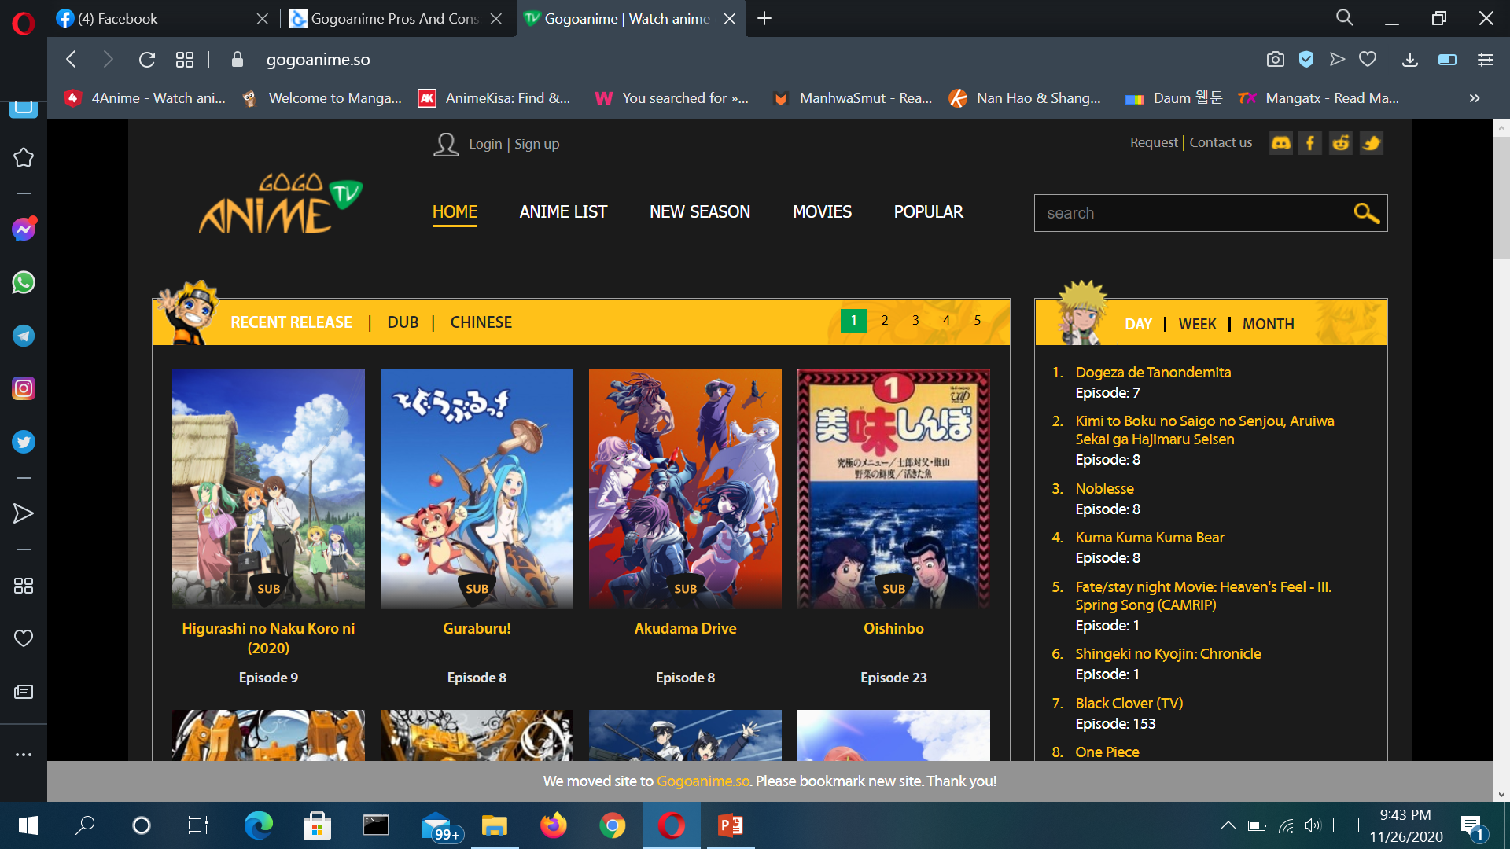
Homepage of animekisa

Slide 5
Is it legal to stream anime from Gogoanime website?
No, it is not legal since they do not have the streaming rights for anime shows. Not only this, but Gogoanime does not have any monitored ads or subscription fees charged from its users. However, this does not mean that you need to worried about the virus while downloading content from this website. The torrent links provided on the website are genuine and trustworthy and so you do not have to worry about it.
The popularity of Gogoanime is due to the free streaming on its website offering you good Japanese entertainment. This is due to the various reasons, like the creation stories, impactful characters and all the amazing entertainment they offer.

Slide 6
What are the things I should know about Gogoanime?
Most people who surf anime content do not know certain things before surfing the Gogoanime website. Gogoanime offers you with the free online anime streaming to its users. However, there is one drawback with the use of the website.
You have to take care of the Gogoanime.to browser can enter your system without any permission. Once it has entered your system who will only see the numbers on the ad on your screen.

Slide 7
What the best features of Gogoanime?
Gogoanime is one stop for people who want to watch free anime shows and stream them live on their computer screen. Gogoanime has some outstanding features associated with it, which include the following:
You can find all genres of anime content right from action, drama, kids, fantasy, horror, mystery, police, romance, school, comedy, music, game and many more. All you have to do is search the type of anime you are looking for and you will have the list of shows.
You can find that so many series that are updated every day.
You can find the anime content which is either English dubbed or has English subtitles with it.
Gogoanime is always at your service for any type of business inquiry or any other kind of query.

Slide 8
.
There are some shows listed as new releases, new seasons or according to the watchlist, scheduled list and many more all customized for you.
You can download your favorite episode without paying any type of subscription fees.
To access the content all, you have to do is fill up a form or you can contact them directly from your email.
Gogoanime is fast as compared to the other anime websites that are available on the internet. The site is excellent while running and is smooth without any pop-up ads or any type of buffering. You can easily download all your shows without any hassle.
The website is even safe for the user to browse and has excellent reviews for its stability and protection as well.
The quality of the anime content is high, so all you have to do is enjoy the best anime entertainment on your computer screens.

Slide 9
Who can use GoGoAnime?
Everyone who have internet connection and a simple device with browser can use GoGoAnime. Unfortunately some countries, instead of going after the people that upload and distribute the anime, ban GoGoAnime.

Slide 10
Is Gogoanime safe to use?
This is a very common question in the mind of every user that is Gogoanime safe to use on your computer. As the website is not legalized for showing the anime content on its website, many people think that browsing the content on the website might harm their computer. Yes, the website is safe to use until you are clicking at inappropriate links and ads. That is when you might open applications that can cause harm to your computer. Although, the website is illegal since they are not legalized to show the content on their website, however, the streaming quality is genuine for being used.

Slide 11
Is Gogoanime free of cost?
Yes, Gogoanime offers you with the free online anime streaming to its users.

